Slide 1
Implementation III

Slide 2
Objectives
Survey Line Drawing Algorithms
DDA
Bresenham

Slide 3
Rasterization
Rasterization (scan conversion)
Determine which pixels that are inside primitive specified by a set of vertices
Produces a set of fragments
Fragments have a location (pixel location) and other attributes such color and texture coordinates that are determined by interpolating values at vertices
Pixel colors determined later using color, texture, and other vertex properties

Slide 4
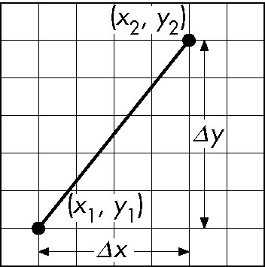
Scan Conversion of Line Segments
Start with line segment in window coordinates with integer values for endpoints
Assume implementation has a write_pixel function
y = mx + h

Slide 5
DDA Algorithm
Digital Differential Analyzer
DDA was a mechanical device for numerical solution of differential equations
Line y=mx+ h satisfies differential equation
dy/dx = m = Δy/Δx = y₂-y₁/x₂-x₁
Along scan line Δx = 1
Y = y1;
for(x=x1; x<=x2,x++) {
y+=m;
write_pixel(x, round(y), line_color)
}

Slide 6
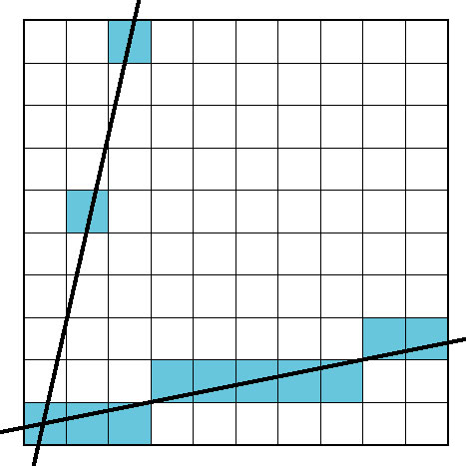
Problem
DDA = for each x plot pixel at closest y
Problems for steep lines

Slide 7
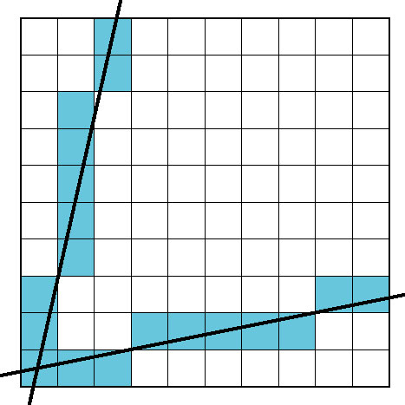
Using Symmetry
Use for 1 ≥ m ≥ 0
For m > 1, swap role of x and y
For each y, plot closest x

Slide 8
Bresenham’s Algorithm
DDA requires one floating point addition per step
We can eliminate all fp through Bresenham’s algorithm
Consider only 1 ≥ m ≥ 0
Other cases by symmetry
Assume pixel centers are at half integers
If we start at a pixel that has been written, there are only two candidates for the next pixel to be written into the frame buffer

Slide 9
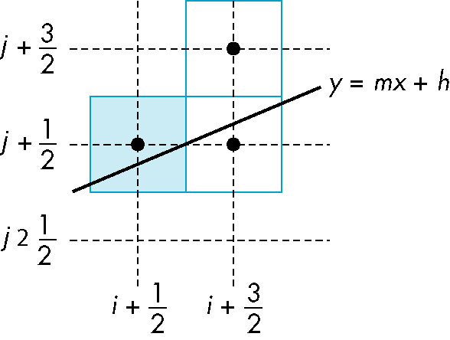
Candidate Pixels
1 ≥ m ≥ 0
candidates
last pixel
Note that line could have
passed through any
part of this pixel

Slide 10
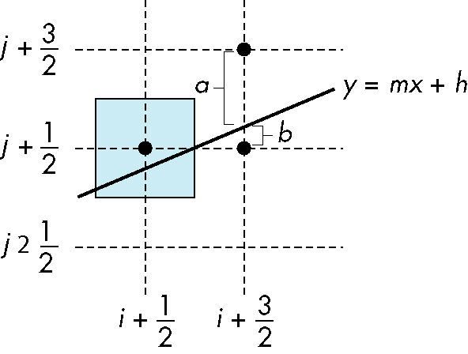
Decision Variable
d = Δx(b-a)
d is an integer
d > 0 use upper pixel
d < 0 use lower pixel
-

Slide 11
Incremental Form
More efficient if we look at d_{k}, the value of the decision variable at x = k
d_{k+1}= d_{k} + 2Δy, if d_{k} <0
d_{k+1}= d_{k} + 2(Δy - Δx), otherwise
For each x, we need do only an
integer addition and a test
Single instruction on graphics chips

Slide 12
Example
Consider line from (20,10) to (30,18)
Δx = 10,
Δy = 8,
2Δy = 16
2(Δy-Δx) = -4
d = 2Δy-Δx = 6
d | x | y
6 | 21 | 11
2 | 22 | 12
-2 | 23 | 12
14 | 24 | 13
10 | 25 | 14
6 | 26 | 15
2 | 27 | 16
-2 | 28 | 16
14 | 29 | 17
10 | 30 | 18
Angel: Interactive Computer Graphics 5E © Addison-Wesley 2009
12

Slide 13

Polygon Scan Conversion
Scan Conversion = Fill
How to tell inside from outside
Convex easy
Nonsimple difficult
Odd even test
Count edge crossings
Winding number
odd-even fill

Slide 14
Winding Number
Count clockwise encirclements of point
Alternate definition of inside: inside if winding number ≠ 0
winding number = 1
winding number = 2

Slide 15
Filling in the Frame Buffer
Fill at end of pipeline
Convex Polygons only
Nonconvex polygons assumed to have been tessellated
Shades (colors) have been computed for vertices (Gouraud shading)
Combine with z-buffer algorithm
March across scan lines interpolating shades
Incremental work small

Slide 16
Using Interpolation
C₁ C₂ C₃ specified by glColor or by vertex shading
C₄ determined by interpolating between C₁ and C₂
C₅ determined by interpolating between C₂ and C₃
interpolate between C₄ and C₅ along span
C₁
C₄
C₂
scan line
C₅
span
C₃

Slide 17
Flood Fill
Fill can be done recursively if we know a seed point located inside (WHITE)
Scan convert edges into buffer in edge/inside color (BLACK)
flood_fill(int x, int y) {
if(read_pixel(x,y)= = WHITE) {
write_pixel(x,y,BLACK);
flood_fill(x-1, y);
flood_fill(x+1, y);
flood_fill(x, y+1);
flood_fill(x, y-1);
} }

Slide 18
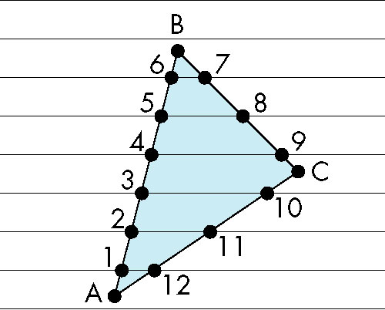
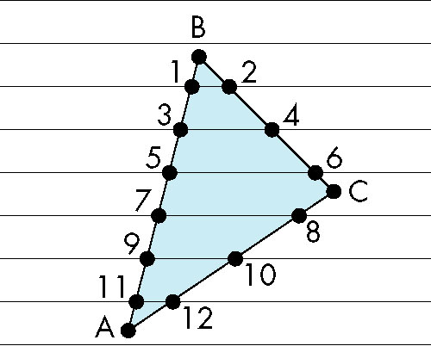
Scan Line Fill
Can also fill by maintaining a data structure of all intersections of polygons with scan lines
Sort by scan line
Fill each span
vertex order generated
by vertex list
desired order

Slide 19
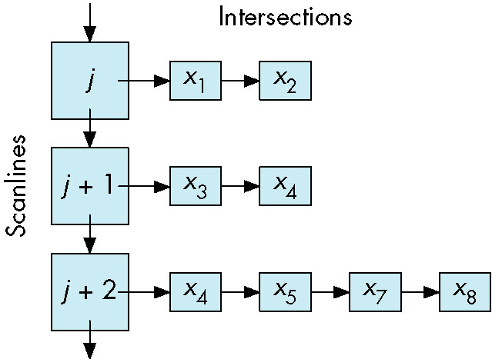
Data Structure

Slide 20
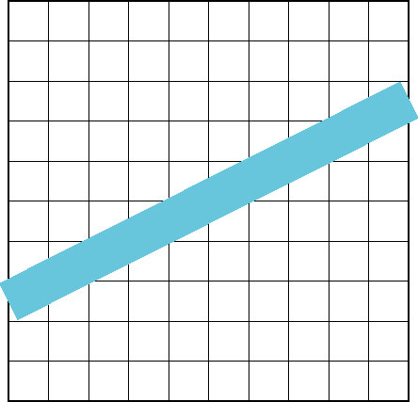
Aliasing
Ideal rasterized line should be 1 pixel wide
Choosing best y for each x (or visa versa) produces aliased raster lines

Slide 21
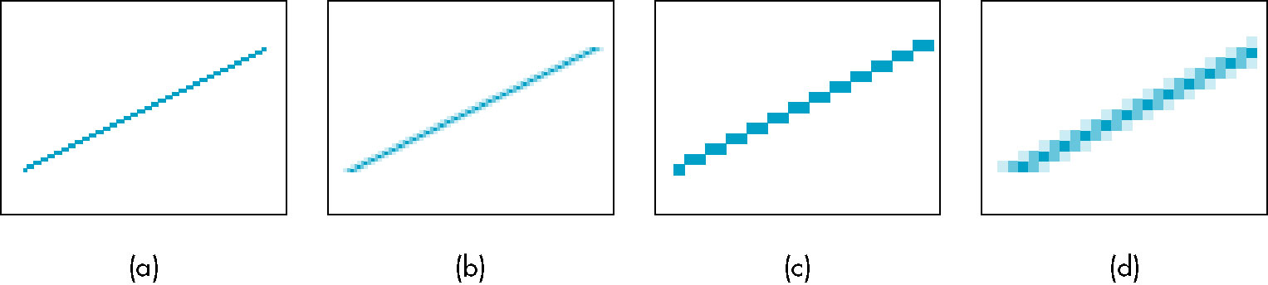
Antialiasing by Area Averaging
Color multiple pixels for each x depending on coverage by ideal line
original
antialiased
magnified

Slide 22
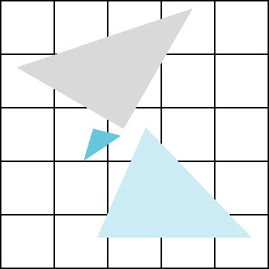
Polygon Aliasing
Aliasing problems can be serious for polygons
Jaggedness of edges
Small polygons neglected
Need compositing so color
of one polygon does not
totally determine color of
pixel
All three polygons should contribute to color

